Slide 1
Assignment 1 – Crimes and Real Estate
- Team 4

Slide 2
Agenda
Datasets & Why?
Complex Questions
Code Snippets/Technical Highlights
Ontology
Technical Challenges Encountered

Slide 3
Datasets
CSV from Zillow, containing the monthly house price index of different neighborhoods in LA, from 2010 to present.
CSV from data.lacity.org, containing crime records of LA, from 2010 to present.
Available
OPEN DATA
Relation between the datasets
Format: CSV

Slide 4
Complex Questions
How do different types of crime affect housing prices in different neighborhoods of Los Angeles?
Are some types of crime more likely to have an impact on housing prices than others?
Can we identify any areas in Los Angeles where both housing prices and crime rates are increasing or decreasing rapidly? Are these trends linked, or there are other factors at play?

Slide 5
Code Snippets/Technical Highlights

Slide 6
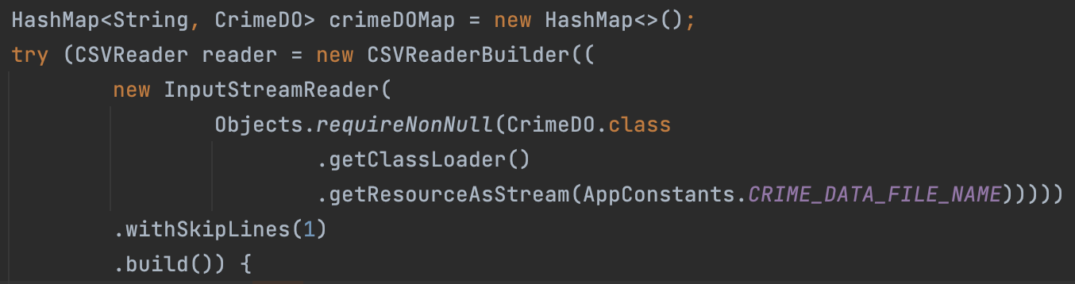
Steps
1. Parse the datasets

Slide 7
Steps
2.Create the OWL Model – Model Creation, Class, Properties, comments, etc.

Slide 8
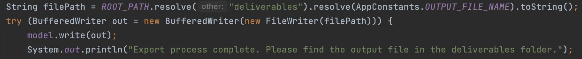
Steps
3. Write to File

Slide 9
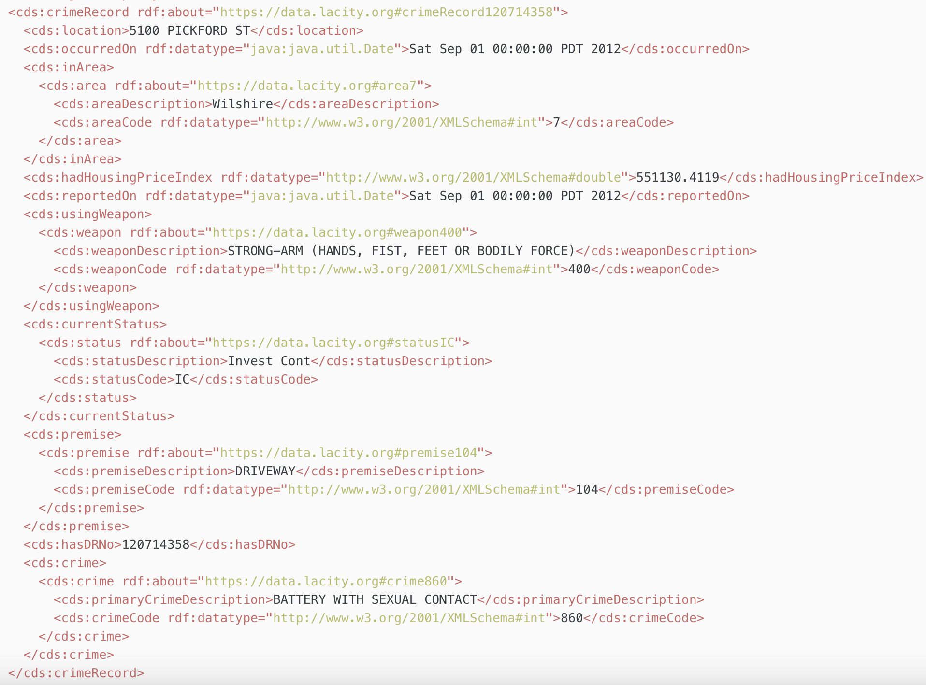
Sample Record

Slide 10
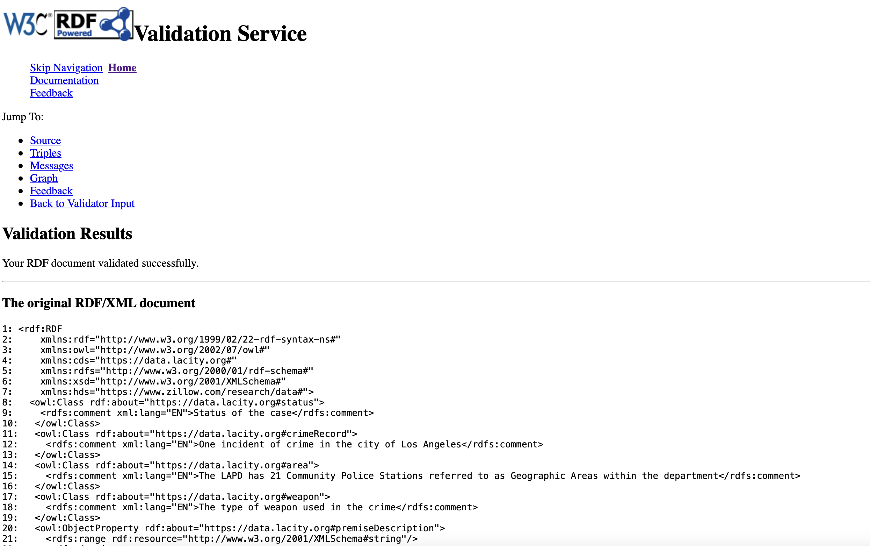
Validating the output

Slide 11
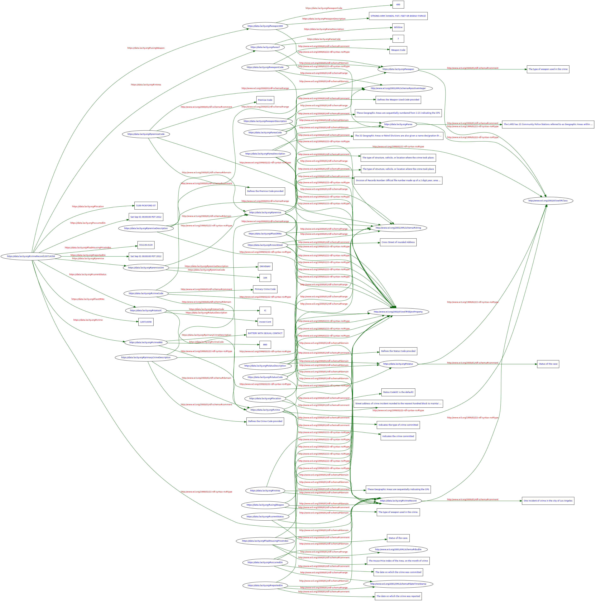
Ontology

Slide 12
Technical Challenges Encountered
Space availability in GitHub
New concepts
Dataset Integrations

Slide 13
Project Link
https://github.com/sreeharshakv/web-semantics/tree/develop

Slide 14
Questions

Slide 15

Thank You

